Slide 1

Finding Attrition rate in a company
MIS 6324: BUSINESS ANALYTICS WITH SAS PROJECT PRESENTATION
GROUP: 3
Vinay Manideep Cheviti
Vamshi Enishetty
Harshavardhan Yarlagadda
Venkata Sarath Chandra Muktevi

Slide 2
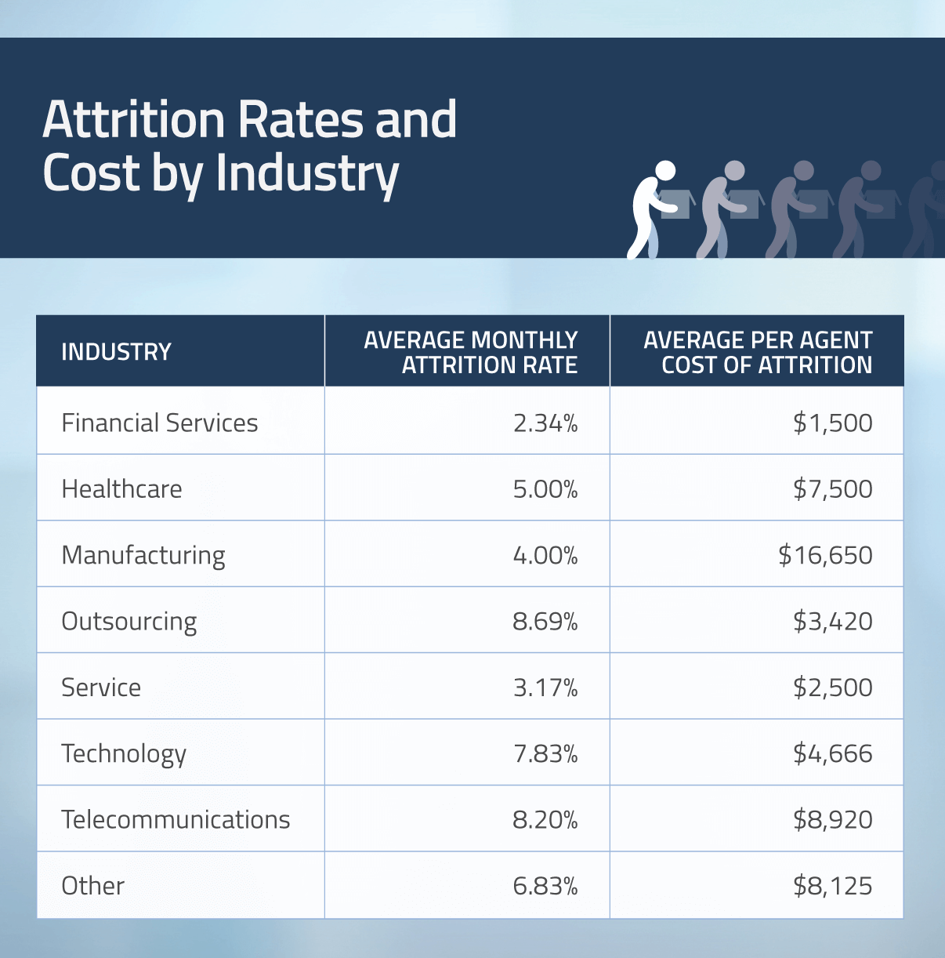
Statistics in the Year 2010
Image Source: https://www.contactcenterworld.com/company/blog/furstperson/?id=c93fca5f-a8f7-4e71-83b0-db62bd4cb7d3

Slide 3
Contents
Objective and Motivation
Data description
Data Preprocessing
Data Partition
Predictive Analysis
Model Comparison
Conclusion

Slide 4
Data Mining Objective and Motivation
Objective
To predict the likelihood of a person leaving a company (Attrition rate), to analyze the elements which are contributing towards this factor, and to analyze the descriptive pattern among data set.

Slide 5
Data set Description
Second-hand dataset named ‘IBM HR Analytics Employee Attrition and Performance’
https://www.kaggle.com/pavansubhasht/ibm-hr-analytics-attrition-dataset
The data consists of 35 attributes related to Employees.

Slide 6


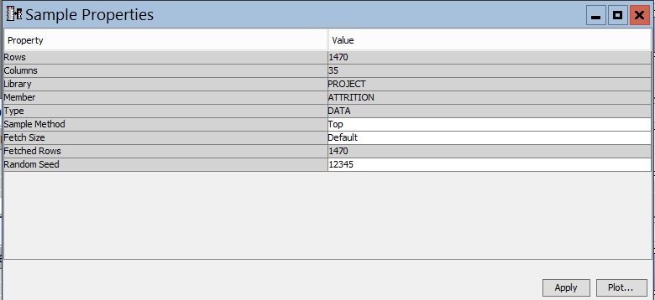
Data summary
Total of 1470 rows and 35 columns in our data set

Slide 7
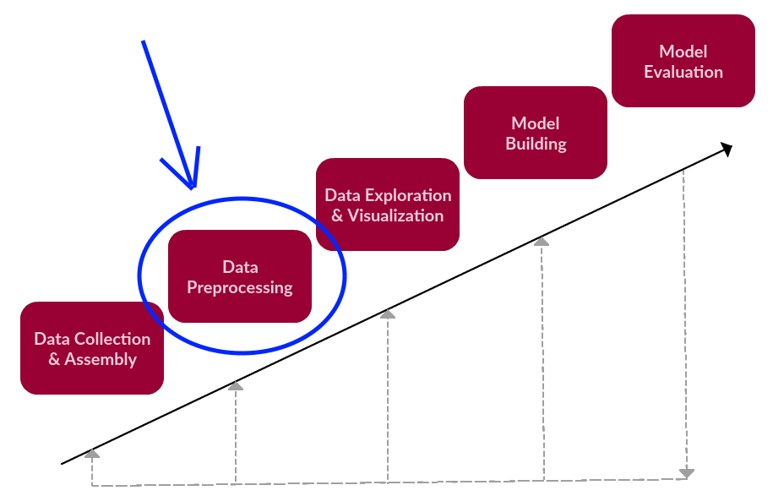
Data Preprocessing
It is a Data Mining technique which involves formatting and transforming inconsistent, incomplete, real world raw data into a consistent and complete understandable data.

Slide 8
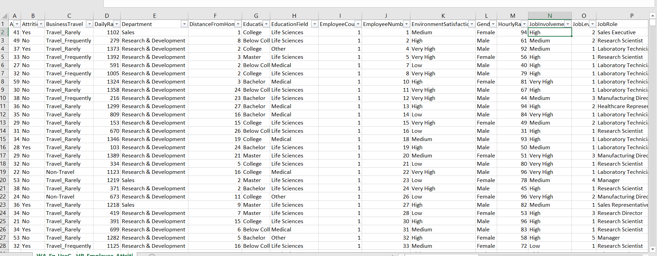
Here the data format of Education Column from 1,2,3,4,5 is changed to 1 'Below College' 2 'College' 3 'Bachelor' 4 'Master' 5 'Doctor
Data format of Environment Satisfaction from 1,2,3,4 to 1 'Low' 2 'Medium' 3 'High' 4 'Very High’.
Data format of Job Involvement from 1,2,3,4 to 1 'Low' 2 'Medium' 3 'High' 4 'Very High'.

Slide 9
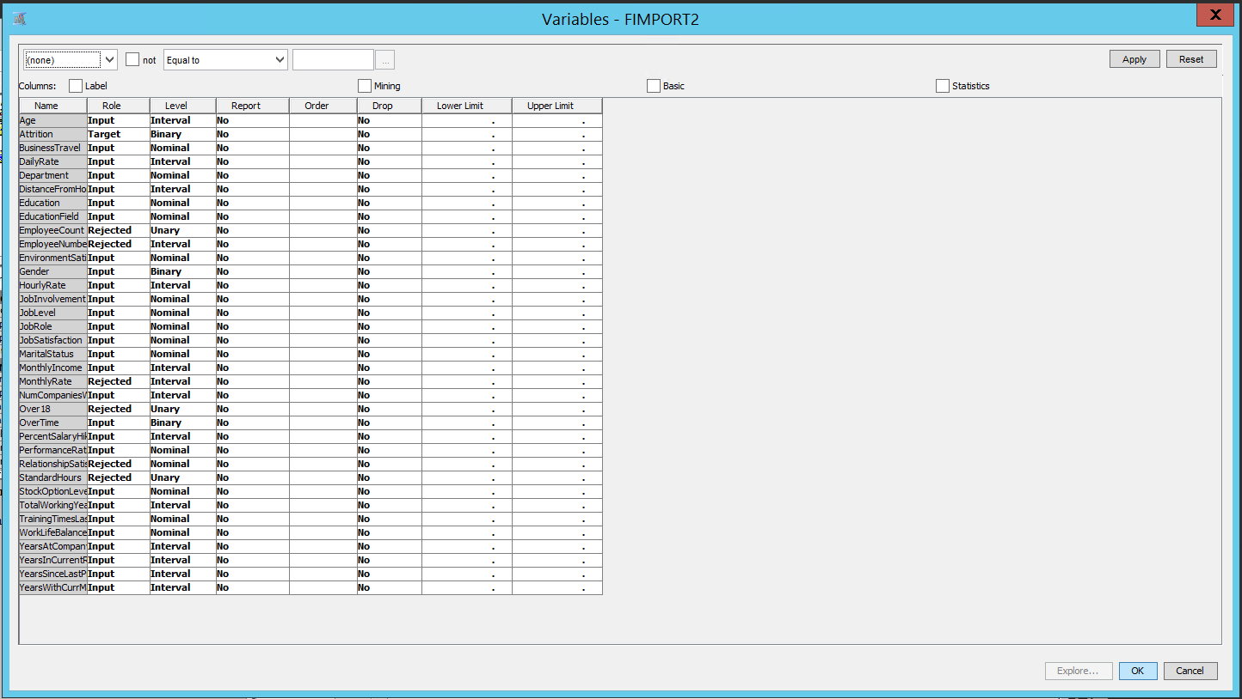
Removed Columns Employee Number (Not relevant), Standard Hours (Unary Data), over 18 (Unary Data), Employee Count (Unary Data), Relationship Satisfaction (Not relevant), these variables seems to be out of context in finding Attrition Rate.

Slide 10
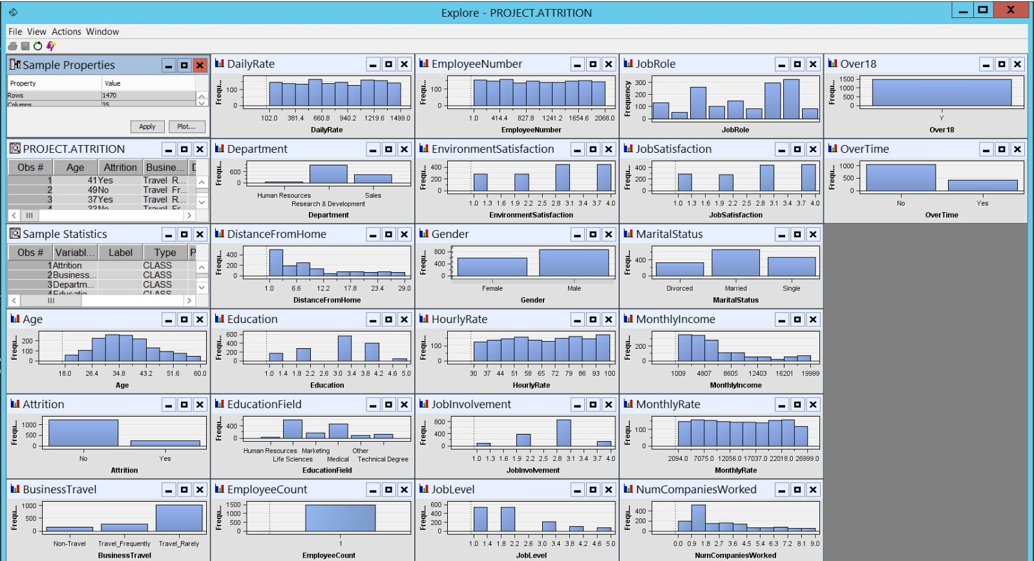
Before Preprocessing

Slide 11
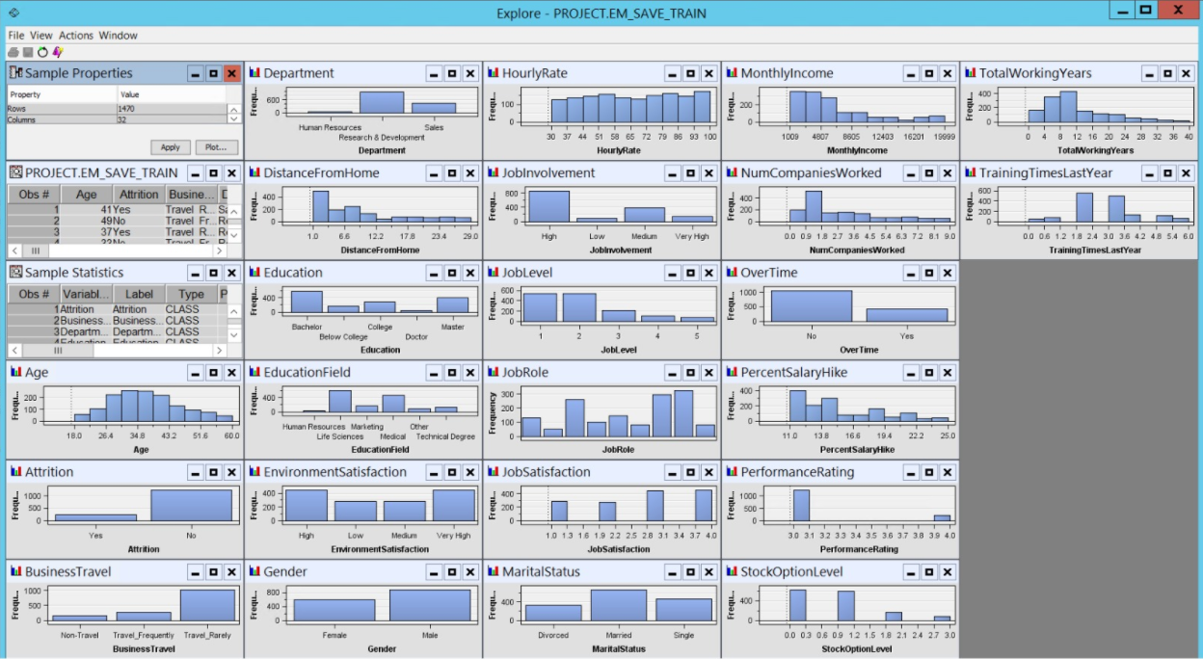
after Preprocessing

Slide 12
Final Data Preprocessing
As there were no missing values in our dataset , we didn’t perform data impute.
Also there was no need of using the data replacement node.

Slide 13
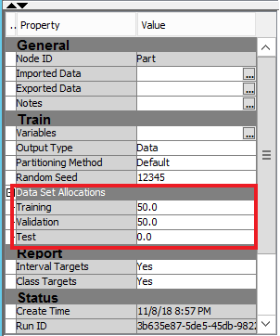
Data partition
For Model Building we require a Training dataset.
For Model Validation we require a Validation Dataset.

Slide 14
Predictive Analysis
We have used four different models for predictive analysis:
Decision Tree
Logistic Regression
Neural Network
Gradient Boosting

Slide 15
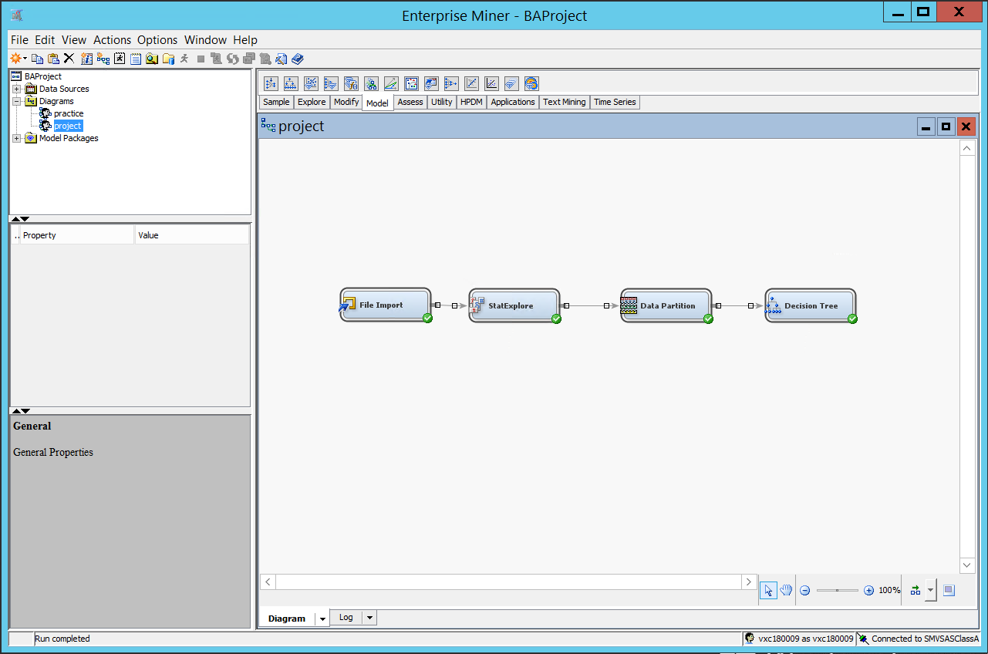
Decision Tree
Decision Tree is a Type of classification in which the analysis on a dataset is performed by using a tree structure which is constructed in a Top-Down recursive partitioning manner.

Slide 16
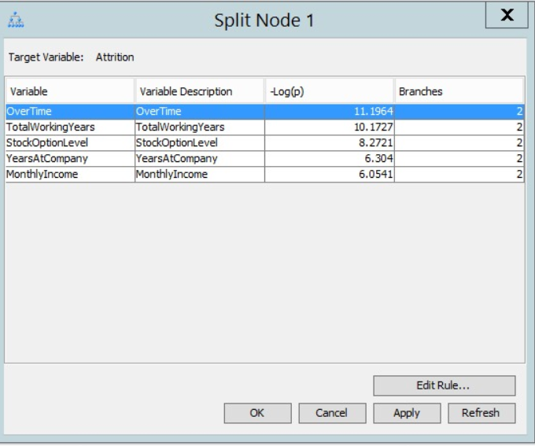
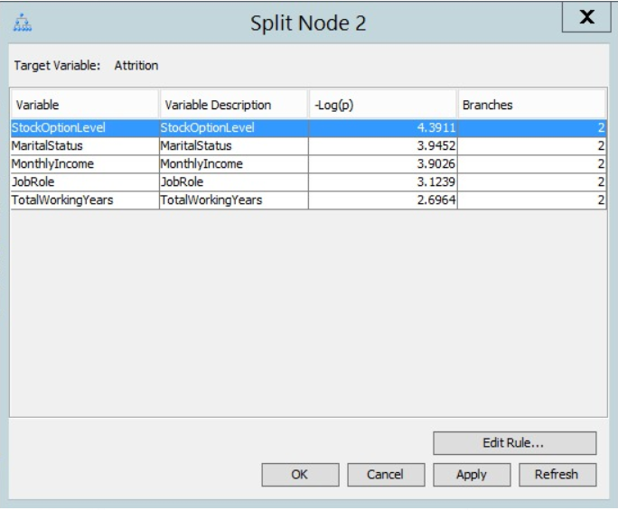
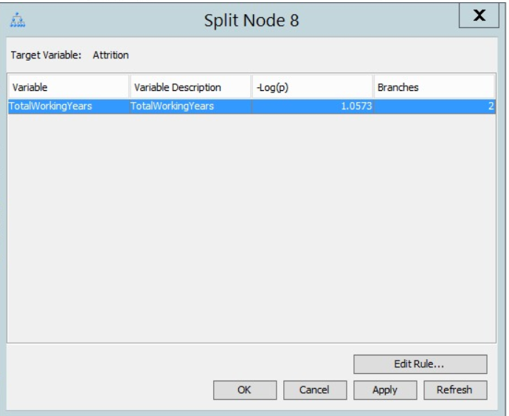
SPLIT NODES IN DECISION TREE

Slide 17
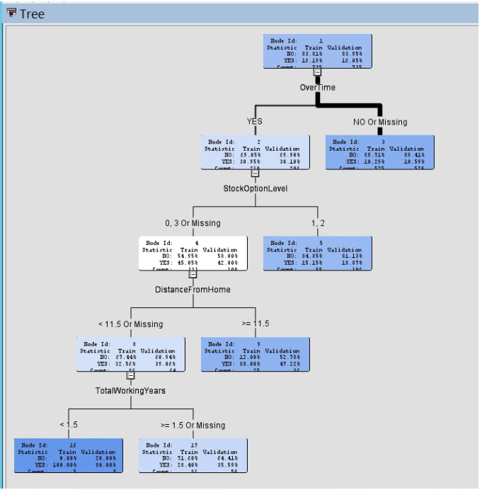
DECISION TREE structure

Slide 18
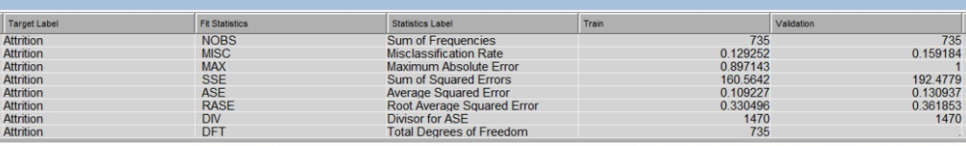
Accuracy rate of decision tree
Accuracy Rate = 1-Misclassification Rate
=1-0.1592 = 0.8408
84% Accurate

Slide 19
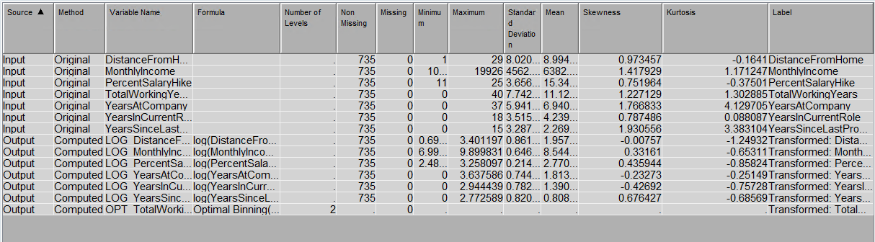
Data transformation
Data transformations on the variables which affect the target variable to reduce the skewness of the data.

Slide 20
Logistic Regression
We have Performed Logistic Regression for all the four Selection Models.
Selection Model as None
Forward Regression
Backward Regression
Stepwise Regression

Slide 21
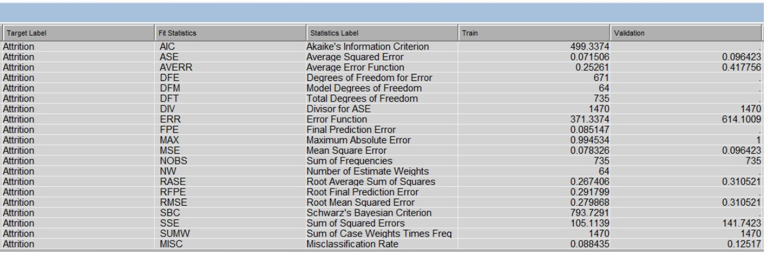
Logistic Regression with selection model as none
Accuracy Rate = 1-Misclassification Rate
=1-0.12517 = 0.87483
87.5% Accurate

Slide 22
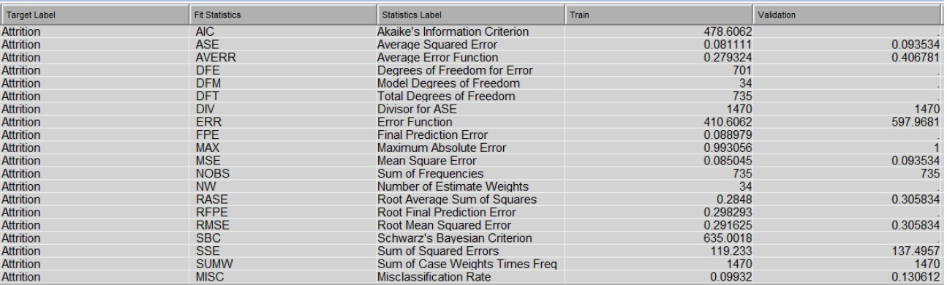
Logistic Regression- Forward Regression
Accuracy Rate = 1-Misclassification Rate
=1-0.130612 = 0.869388
86.9% Accurate

Slide 23
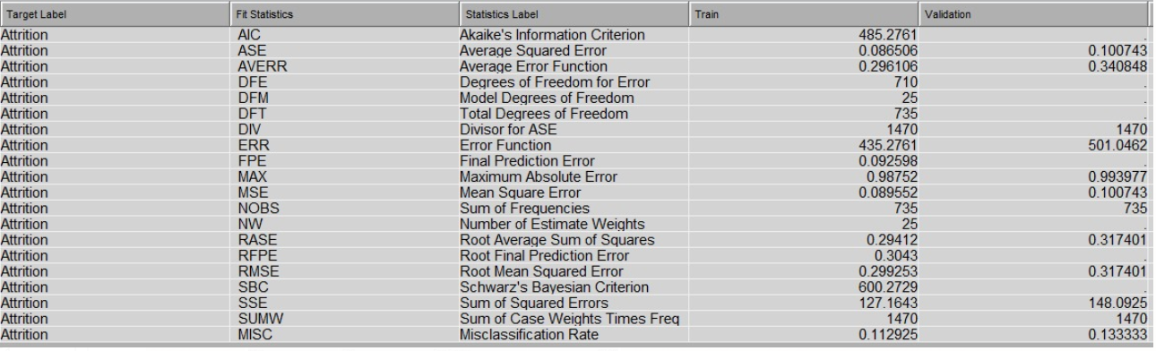
Logistic Regression – Backward Regression
Accuracy Rate = 1-Misclassification Rate
=1-0.13333 = 0.86667
86.67% Accurate

Slide 24
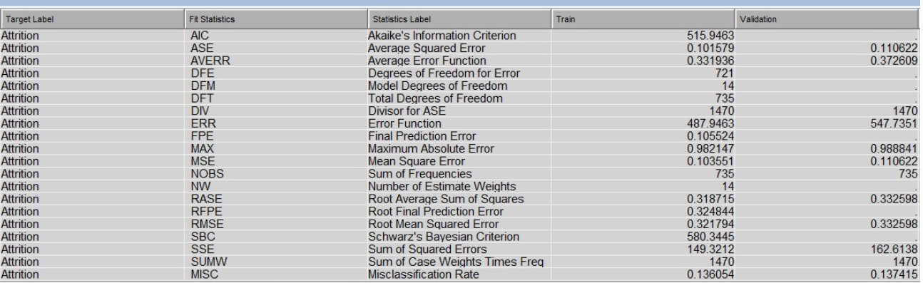
Logistic Regression – Step-wise Regression
Accuracy Rate = 1-Misclassification Rate
=1-0.137415 = 0.862585
86.26% Accurate

Slide 25
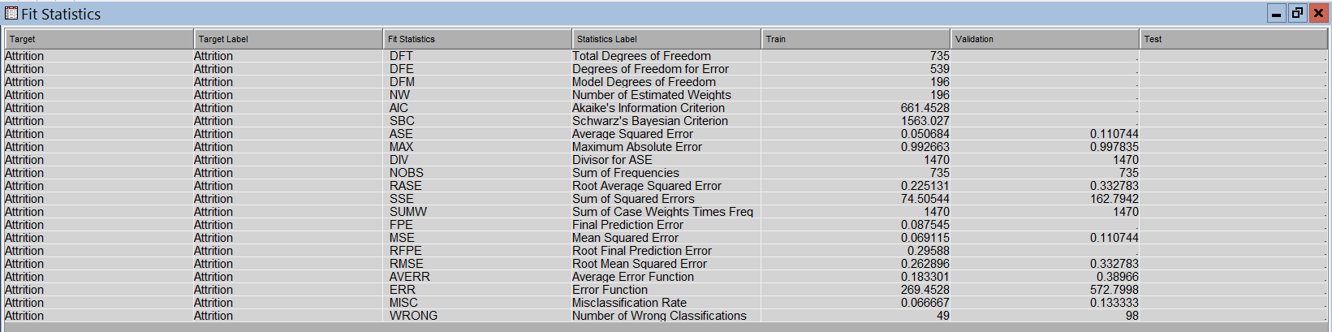
Neural Network
Accuracy Rate = 1-Misclassification Rate
=1-0.13333 = 0.86667
86.67% Accurate

Slide 26
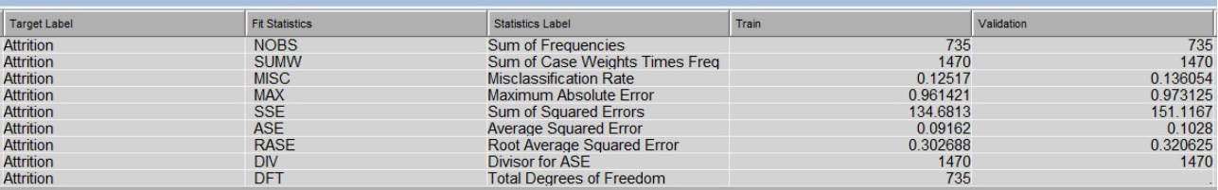
Gradient Boosting
Accuracy Rate = 1-Misclassification Rate
=1-0.136054 = 0.863946
86.39% Accurate

Slide 27
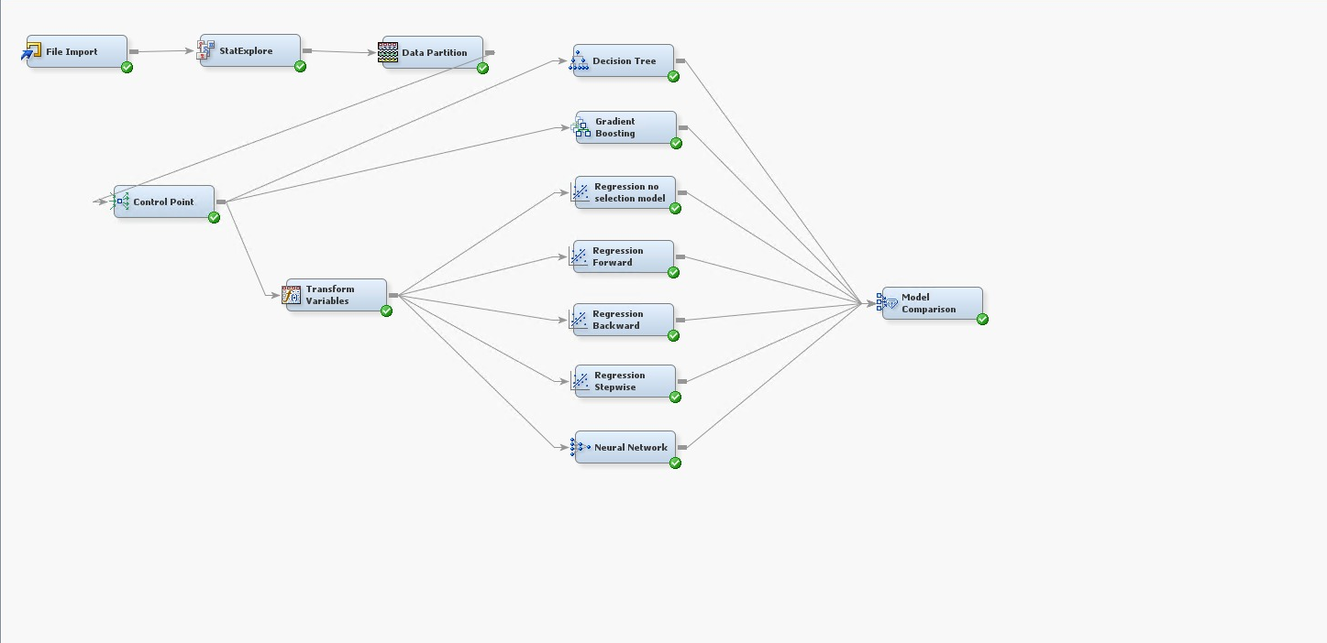
Final Model

Slide 28
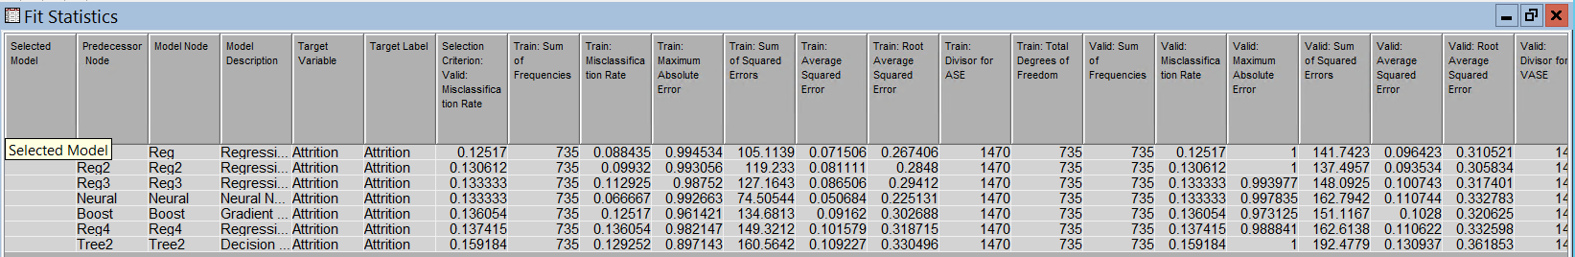
Model comparison
Connected the models to Model Comparison node to find the best model.
Considered the misclassification rates for Train and Validation data sets and accuracy calculated using Confusion Matrix.
‘Logistic Regression’ with selection model as None is the best model for predicting Attrition Rate.

Slide 29
Conclusion
After running 7 statistical models on the processed dataset, we found that OverTime, BusinessTravel, StockOptionLevel are the three significant variables which have greater impact on an Employee leaving a company compared to other variables.
Considering Misclassification Rate we concluded that for predicting the likelihood of attrition, Regression with Selection Model None is the best possible model.

Slide 30

QUERIES ?

Slide 31


